Slide 1
Go language
Anand Hariharan
Practice Head, Google

Slide 2
Module 8
Custom packages in Go

Slide 3
Why packages?
Bundling code in packages serves 3 purposes:
It reduces the chance of having overlapping names. This keeps our function names short and succinct
It organizes code so that its easier to find code you want to reuse.
It speeds up the compiler by only requiring recompilation of smaller chunks of a program.
Example: Although we use the package fmt, we don't have to recompile it every time we change our program.

Slide 4
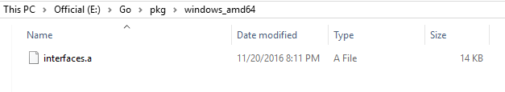
Packages
The first statement in a Go source file must be
package <name>
where name is the package's default name for imports.
All files in a package must use the same name.
Follow these steps:
Run “go build <filename.go>”
Go to folder within which the package is located
Run “go install”. This creates a package_name.a

Slide 5
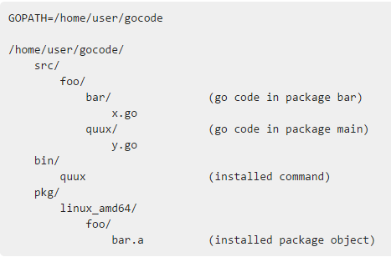
Package build
Package build gathers information about Go packages.
The src/ directory holds source code.
The path below 'src' determines the import path or executable name.
Notes:
https://golang.org/pkg/go/build/

Slide 6
Documenting packages
Use “godoc <package_name>” command to create package documentation

Slide 7
Anand Hariharan
Practice Head
anand.hariharan@wipro.com

